Slide 1
Linear Regression and Support Vector Machines
Marcus Rüb
Hahn-Schickard Villingen-Schwenningen
Marcus.rueb@hahn-schickard.de
Notes:
Ob intelligenter Kühlschrank oder Sprachassistent, bereits heute sind in unserem Alltag viele Dinge mit künstlicher Intelligenz ausgestattet. Im Zeitalter des Internet of Things (IoT) und der Industrie 4.0 werden intelligente Systeme immer wichtiger.
Zur Ausführung von vielen neuronalen Netzen wird allerdings nicht immer die Rechenleistung von großen und teuren Rechner benötigt. Stattdessen kann hier auch die Rechenleistung eines eingebetteten Systems, wie die eines Mikrocontrollers, ausreichen.
Allerdings ist die Unterstützung von Plattformen zur Ausführung von neuronalen Netzen, nicht ohne weiteres gegeben ist.
Das Modell muss zuerst manuell konvertiert, eingebunden und ausgeführt werden

Slide 2

This session:
Introduction
What is Machine Learning?
Examples
How Machine Learning works?
Machine Learning concepts

Slide 3

Outline for Supervised Learning (1)
Supervised Learning (1)
Linear, polynomial regression
Lasso, Ridge, ElasticNet regression
Logistic Regression
Support Vector Machines (SVM)
Hands-on Supervised Learning
Predict price of vacation rentals in Frankfurt on Airbnb

Slide 4
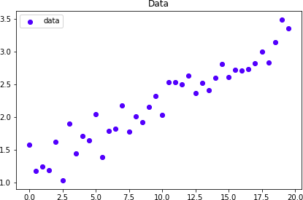
Linear Regression
Let’s create some data
𝑦 = 0.1𝑥 + 1.25 + 0.2𝐺𝑎𝑢𝑠𝑠𝑖𝑎𝑛𝑁𝑜𝑖𝑠𝑒

Slide 5
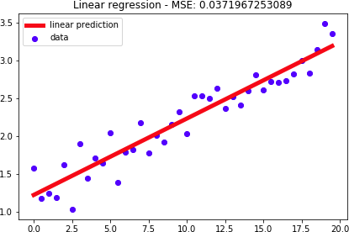
Linear Regression
Let’s perform linear regression…
𝑦 = 0.1𝑥 + 1.25 + 0.2𝐺𝑎𝑢𝑠𝑠𝑖𝑎𝑛𝑁𝑜𝑖𝑠𝑒
𝑦 = 𝑤𝑥 + 𝑏
w = 0.1014
b = 1.2258
𝑦 = 0.1014𝑥 + 1.2258

Slide 6
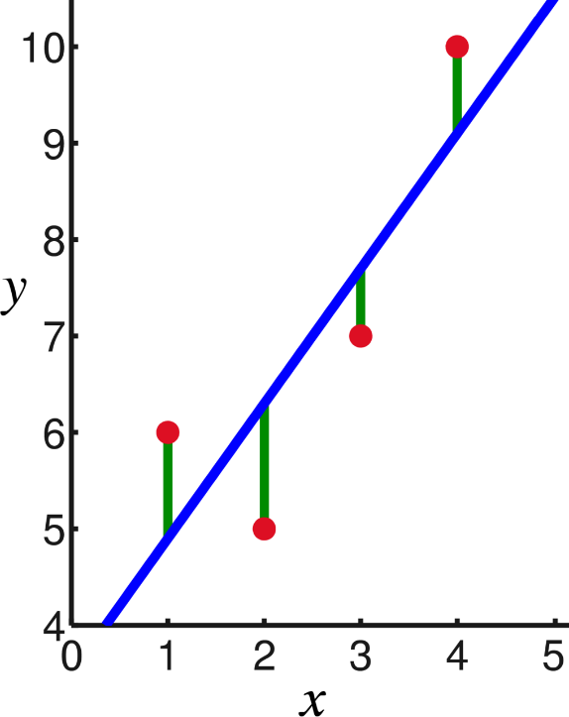
How we fitted the line?
We just found the values of ‘w’ and ‘b’ that minimize the Mean Squared Error
𝑚
1
𝑀𝑆𝐸 = ෍ 𝑌 − 𝑌෡
2
𝑚
𝑖 𝑖
𝑖=1
Mean Squared Error

Slide 7
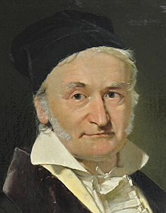
How we fitted the line?
Carl Friedrich Gauss

Slide 8
Least Squares - notation
𝑦 = 𝑤𝑥 + 𝑏 = 𝑏 + 𝑤𝑥
Also called features
𝑋 = 1, 𝑥
𝑊 = 𝑏, 𝑤
𝑦 = 𝑊𝑋 = 𝑏 + 𝑤𝑥
𝑋
=
𝑥₀ = 1
𝑤₀ = 𝑏
𝑥₀, 𝑥₁, 𝑥₂, 𝑥₃, … , 𝑥_{𝑛}
𝑊 = 𝑤₀, 𝑤₁, 𝑤₂, 𝑤₃, … , 𝑤_{𝑛}
𝑦 = 𝑊𝑋 = 𝑤₀𝑥₀ + 𝑤₁𝑥₁ + 𝑤₂𝑥₂ + ⋯ + 𝑤_{𝑛}𝑥_{𝑛}
𝑥₀ | 𝑥_{𝟏} | 𝒚
1 | 0.0 | 1.57
1 | 0.5 | 1.18
1 | 1.0 | 1.24
1 | 1.5 | 1.19
1 | 2.0 | 1.62
X = matrix (m,n) Y = vector (m)
m = number of samples n = number of features

Slide 9
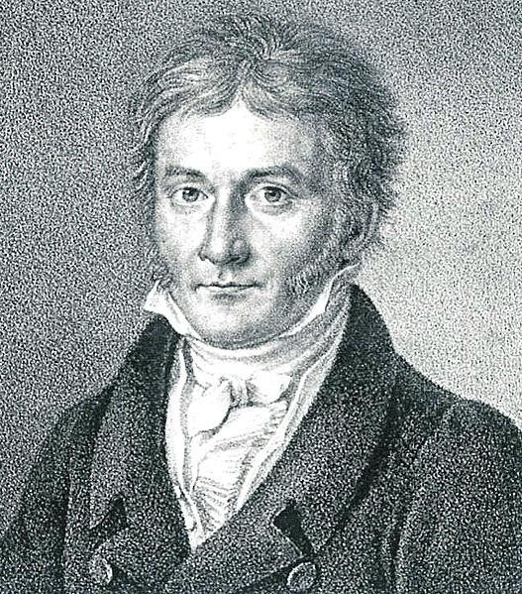
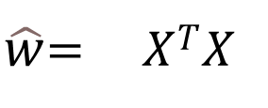
How we fitted the line?
Which values of line parameters minimize the Mean Squared Error?
Least squares Method Least Squares Method
$\hat{w}$= 𝑋^{𝑇}𝑋
−1_{𝑋}𝑇_{𝑦}
𝑋 = 𝑥₀, 𝑥₁, 𝑥₂, 𝑥₃, … , 𝑥_{𝑛}
𝑊 = 𝑤₀, 𝑤₁, 𝑤₂, 𝑤₃, … , 𝑤_{𝑛}
𝑥₀ = 1
𝑤₀ = 𝑏
𝑦 = 𝑊𝑋 = 𝑤₀𝑥₀ + 𝑤₁𝑥₁ + 𝑤₂𝑥₂ + ⋯ + 𝑤_{𝑛}𝑥_{𝑛}
_{𝑊}෡
is the best approximation to W
Carl Friedrich Gauss

Slide 10

How we fitted the line?
Which values of line parameters minimize the Mean Squared Error?
Least squares Method Least Squares Method
$\hat{w}$= 𝑋^{𝑇}𝑋
−1_{𝑋}𝑇_{𝑦}
Carl Friedrich Gauss

Slide 11
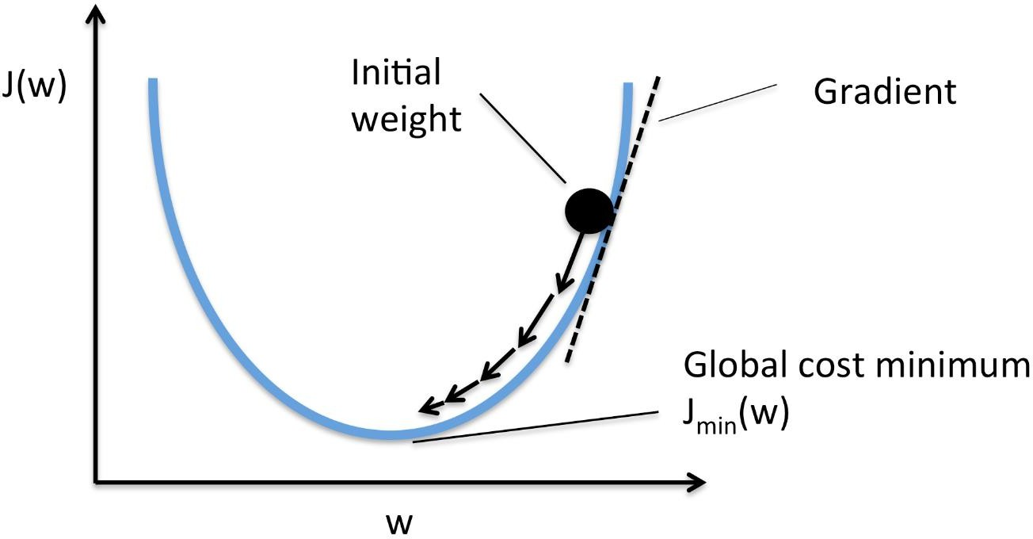
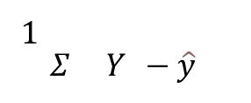
Gradient Descent
There is another way: Gradient Descent
𝑚
1
$Σ$ 𝑌 − $\hat{y}$
2
𝐽 = 𝑀𝑆𝐸 =
𝑖 𝑖
𝑚
Learning
𝜕𝐽
𝑊 = 𝑊 − 𝛼 _{𝜕𝑊}
Gradient Descent Visualization. Credit: rasbt.github.io

Slide 12
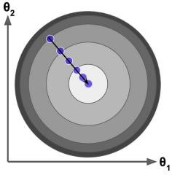
Gradient Descent
There is another way: Gradient Descent

Slide 13
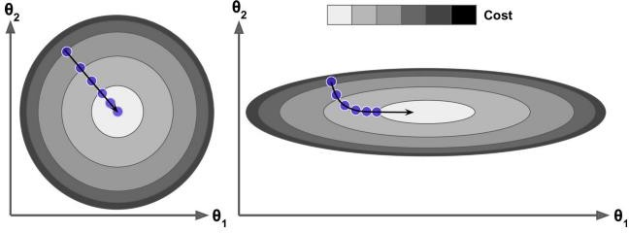
Gradient Descent
When using Gradient Descent we need to normalize the inputs
“normalize” means, put every input in a similar scale
E.g. predict price of a property: n_reviews = [0 – 500], rooms = [1, 8]
Image Credits: Géron, Aurélien. Hands-On Machine Learning with Scikit-Learn and TensorFlow: Concepts, Tools, and Techniques to Build Intelligent Systems (pp. 113-114). O'Reilly Media. Kindle Edition.

Slide 14


$\hat{w}$= 𝑋^{𝑇}𝑋
−1_{𝑋}𝑇_{𝑦}
Least Squares
when there is a relatively small number of features (< 1,000)
Gradient Descent
when there are many features (> 1,000)
when we need to stop training at any time
e.g. if we only have 1 minute
If data does not fit in memory
If you have new data (e.g. stream) and don’t want to start all over (with all previous data)

Slide 15
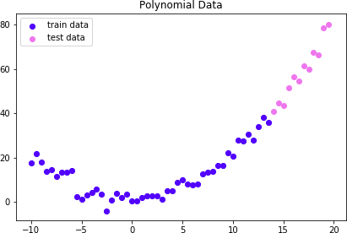
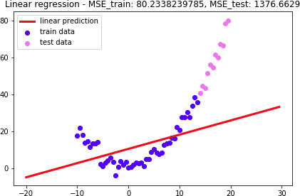
Polynomial Regression
𝑦 = 0.2𝒙^{𝟐} + 0.1𝑥 + 1 + 3𝐺𝑎𝑢𝑠𝑠𝑖𝑎𝑛𝑁𝑜𝑖𝑠𝑒
Linear Regression: y = w₀ + w₁x

Slide 16
Polynomial Regression
You already know how to do it
It is not a new technique, it’s a feature
x
x |  | _{x}2
𝑥₀ | 𝑥_{𝟏} | 𝑥_{𝟐} | 𝒚
1 | -10.0 | 100.0 | 17.74
1 | -9.5 | 90.25 | 21.86
1 | -9 | 81.00 | 17.84
1 | -8.5 | 72.25 | 13.71
1 | -8 | 64.00 | 14.47
𝑥₀ | 𝑥_{𝟏} | 𝒚
1 | -10.0 | 17.74
1 | -9.5 | 21.86
1 | -9 | 17.84
1 | -8.5 | 13.71
1 | -8 | 14.47

Slide 17
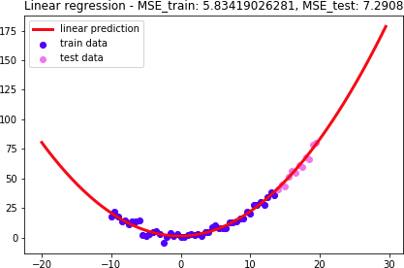
Polynomial Regression
𝑦 = 0.2𝒙^{𝟐} + 0.1𝑥 + 1 + 3𝐺𝑎𝑢𝑠𝑠𝑖𝑎𝑛𝑁𝑜𝑖𝑠𝑒
Linear Regression: y = w₀ + w₁x + w₂x²

Slide 18
Polynomial Regression
Polynomial Regression = Linear Regression with polynomial features
You can get creative:
x², x³, x⁴…
zx², zx³, z²x², …
x |  |  | _{x}2
Features | 𝑥₀ | 𝑥_{𝟏} | 𝑥_{𝟐} | 𝒚
 | 1 | -10.0 | 100.0 | 17.74
 | 1 | -9.5 | 90.25 | 21.86
 | 1 | -9 | 81.00 | 17.84
 | 1 | -8.5 | 72.25 | 13.71
 | 1 | -8 | 64.00 | 14.47

Slide 19

What if some of the inputs are irrelevant?
Ridge Regression
Lasso Regression
ElasticNet Regression

Slide 20
Ridge Regression
Remember Gradient Descent?
1
𝑚
𝑚
෍ 𝑌_{𝑖} − 𝑌෡_{𝑖}
𝐽 = 𝑀𝑆𝐸 =
2
Learning
𝜕𝐽
𝑊 = 𝑊 − 𝛼 _{𝜕𝑊}

Slide 21
Ridge Regression
Upgrade the Cost Function with a regularization term
𝐽 = 𝑀𝑆𝐸
𝑛
1
𝐽 = 𝑀𝑆𝐸 + 𝛼 ෍ 𝑤²
2
𝑗
𝑗=1
𝑙2 𝑝𝑒𝑛𝑎𝑙𝑡𝑦

Slide 22
Lasso Regression
Upgrade the Cost Function with a regularization term
𝐽 = 𝑀𝑆𝐸
𝑛
𝛼 ෍ 𝑤_{𝑗}
𝑗=1
𝐽 = 𝑀𝑆𝐸 +
𝑙1 𝑝𝑒𝑛𝑎𝑙𝑡𝑦

Slide 23
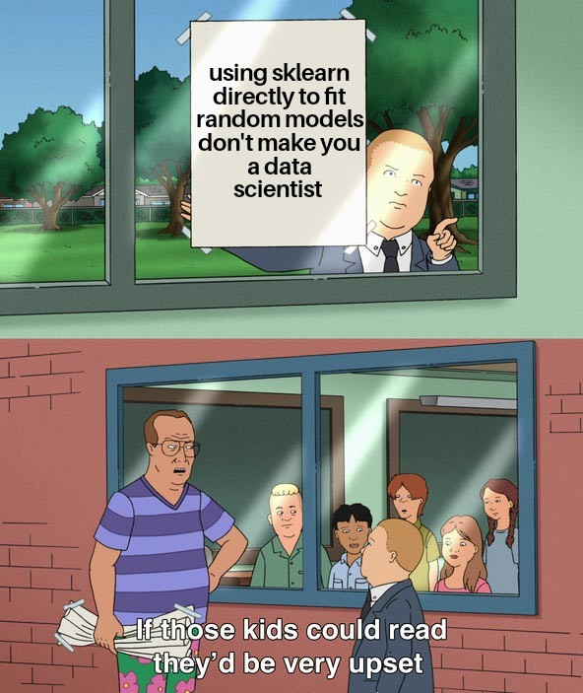
Outlook

